Slide 1
Ngaryan Li
Senior Solicitor
Vauxhall Community Law & Information Centre

Slide 2
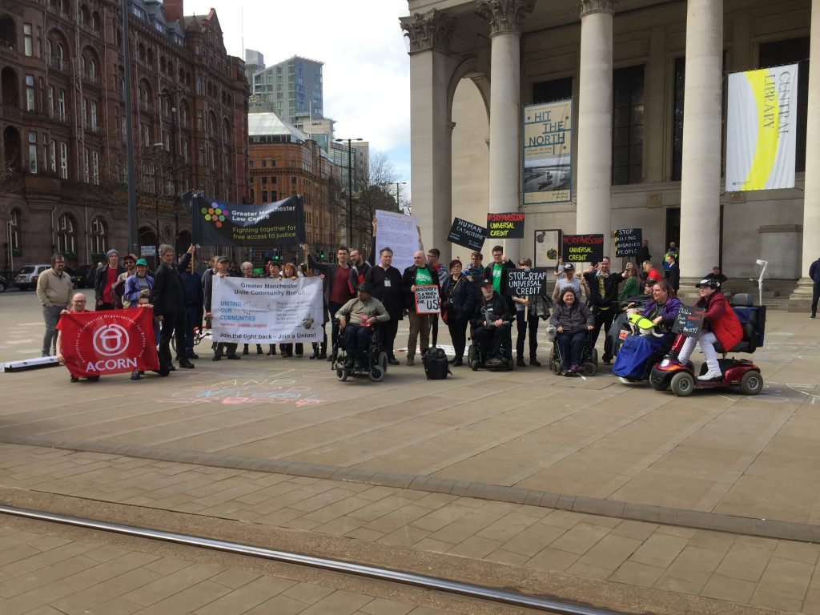
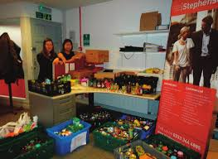
The landscape for people with learning disabilities
Human Rights, The Welfare System and The Risk of Hunger

Slide 3
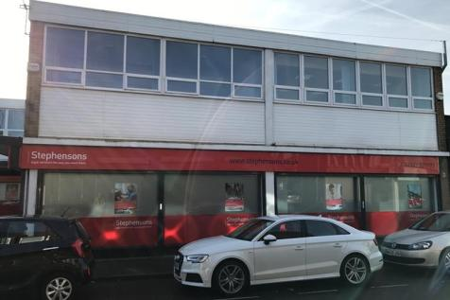
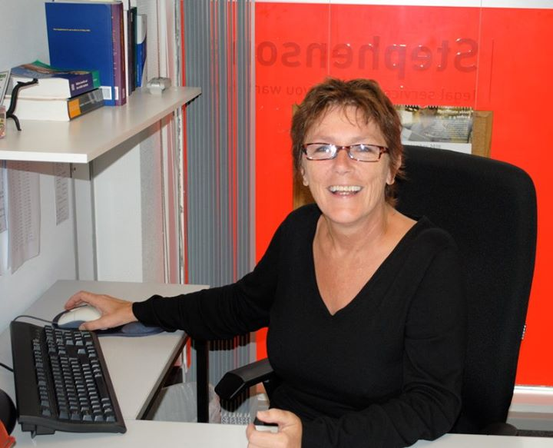
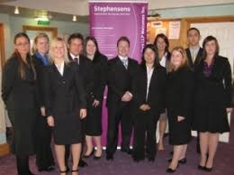
Where it all began... (for me)

Slide 4
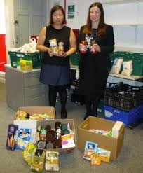
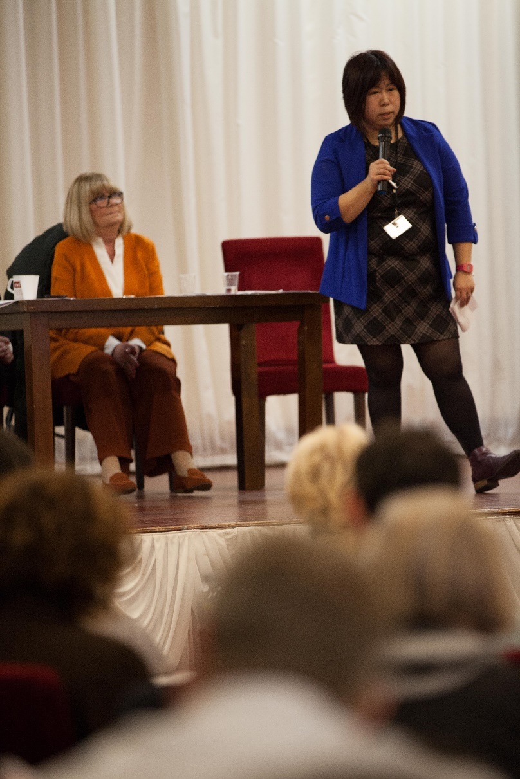
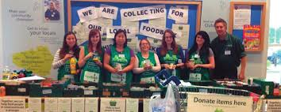
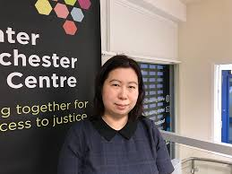
Where it all began... (for me)

Slide 5
What do you think are the difficulties for people with disabilities claiming benefits?

Slide 7
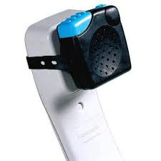
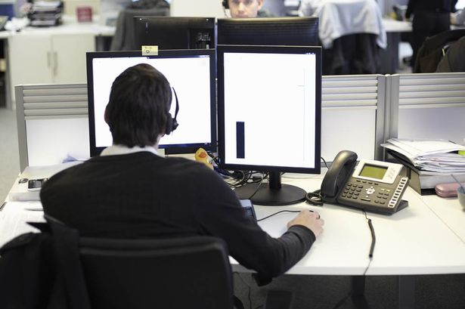

Slide 8
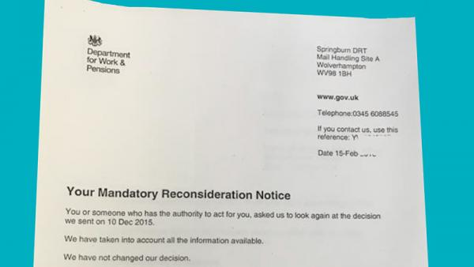
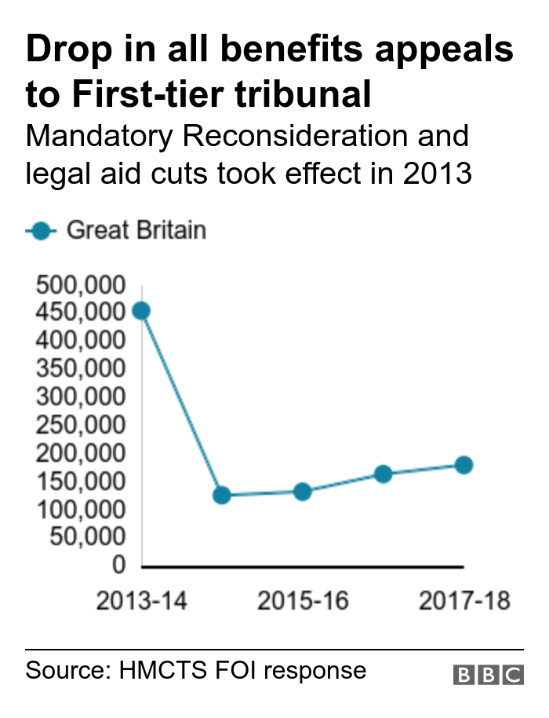
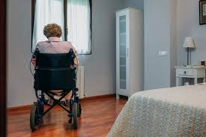

Slide 9
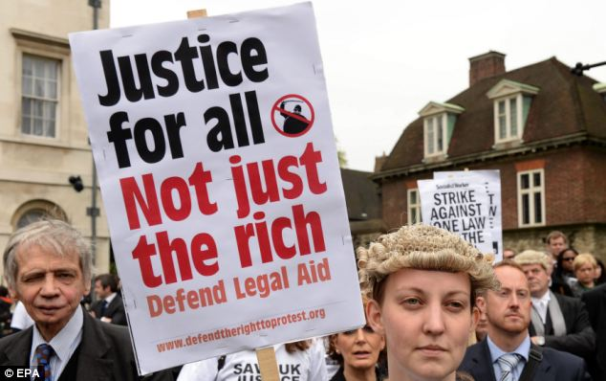
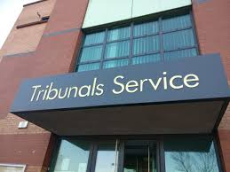

Slide 11
CASE STUDY
33 year old single parent
Works Part time 16 hours per week
4 children aged 12, 10, 6 and 5
Split from partner 18 months ago
Claimed CSA
6 y/o is in receipt of DLA MRC due to autism
Claims WTC, CTC, CB and some help to HB
Ran into debt
Was offered a loan and took it
All benefits (except DLA and CB) stopped
Contacted HMRC
Told that she had claimed UC, therefore all existing benefits would stop
Contacted Police for crime number
DWP confirmed claim for UC made
False claim had been made by ‘loan shark’ – claimed for 2 children
Sought our help in July 2019

Slide 12
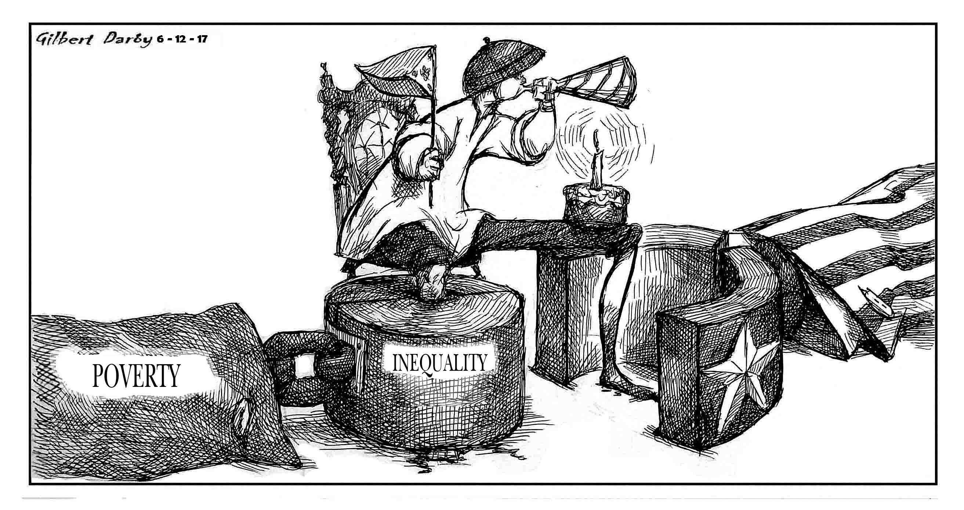
CASE STUDY
Appealed against the decision
Waited for 8 weeks for a response from HMRC
Contacted MP office for intervention
Landlord threatens eviction
Cant afford holiday club for the children
Couldn’t go to work because trying to sort benefits out
Advice given:
1 – appeal against the decision to remain on legacy benefit
2 – claim Universal Credit
October 2019 made claim for UC
Family suffering extreme poverty
Backdate of 1 month

Slide 13
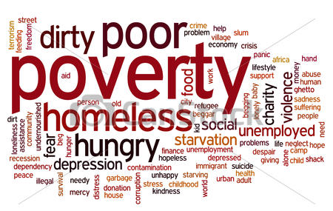
What is Poverty?

Slide 14
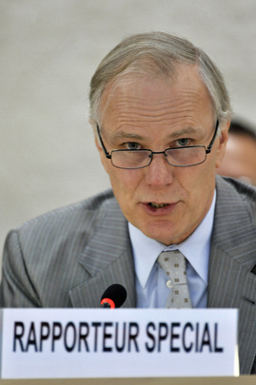
Professor Phillip Alston
Poverty is an urgent human rights concern. For those living in extreme poverty, many human rights are out of reach. Among many other deprivations, they often lack access to education, health services or safe drinking water and basic sanitation. They are often excluded from participating meaningfully in the political process and seeking justice for violations of their human rights. Extreme poverty can be a cause of specific human rights violations, for instance because the poor are forced to work in environments that are unsafe and unhealthy. At the same time, poverty can also be a consequence of human rights violations, for instance when children are unable to escape poverty because the State does not provide adequate access to education.
Human Rights, The Welfare System and The Risk of Hunger

Slide 15
The landscape for people with learning disabilities.
Expectation
Reality

Slide 16
The UK is the world’s fifth largest economy, it contains many areas of immense wealth, its capital is a leading centre of global finance, its entrepreneurs are innovative and agile, and despite the current political turmoil, it has a system of government that rightly remains the envy of much of the world. It thus seems patently unjust and contrary to British values that so many people are living in poverty.
BUT…
The results?
14 million people, a fifth of the population, live in poverty.
4 million of these are more than 50% below the poverty line, and 1.5 million are destitute, unable to afford basic essentials.
Statement on Visit to the United Kingdom, by Professor Philip Alston, United Nations Special Rapporteur on extreme poverty and human rights

Slide 17
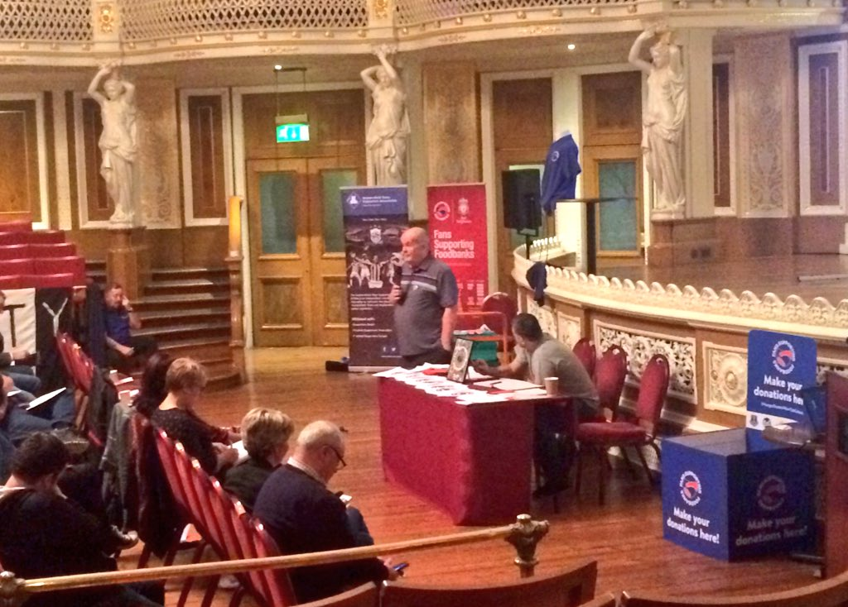
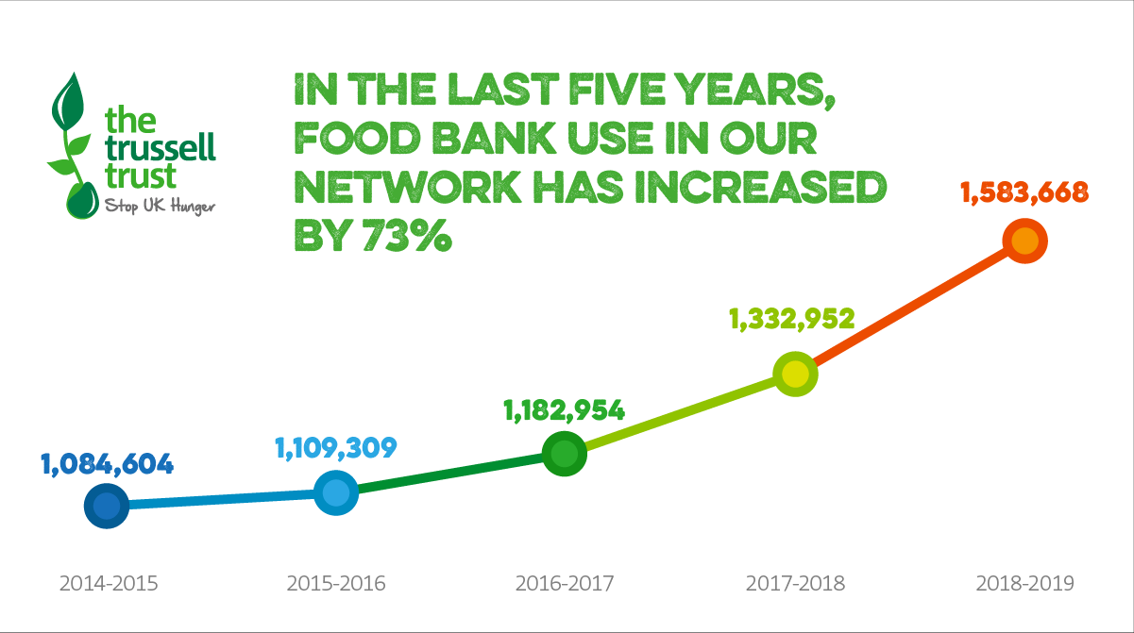

Slide 18
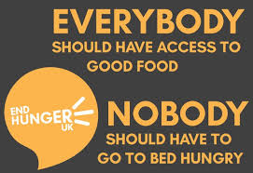
Why the need?
Low benefit income
Delays to benefits
Changes to payment of benefit

Slide 19
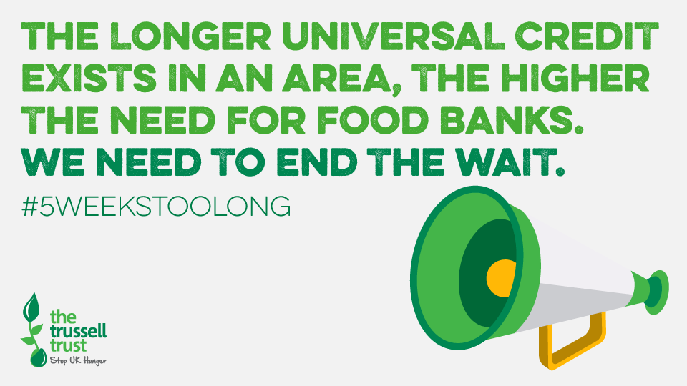
Trussell Trust released State of Hunger, the most in-depth study ever published into hunger and the drivers of food bank use in the UK.
The research revealed:
Average weekly income of households at food banks is only £50 after paying rent
One in five have no money coming in at all in the month before being referred for emergency food
94% of people at food banks are destitute
State of Hunger shows 3 drivers hitting people simultaneously and leaving no protection from hunger and poverty.
problems with the benefits system
ill health or challenging life experiences, and
a lack of local support.
Although Universal Credit is not the only benefit payment people at food banks experience problems with, the majority (65%) of food bank referrals made in April – Sept 2019 due to a delay in benefits being paid in the UK were linked to Universal Credit.
At the moment, people moving onto the government’s new benefits system have to wait at least five weeks – and often longer – with no money.
People can get offered an Advance Payment, but this is a loan that must be paid back, often forcing people into debt.

Slide 20
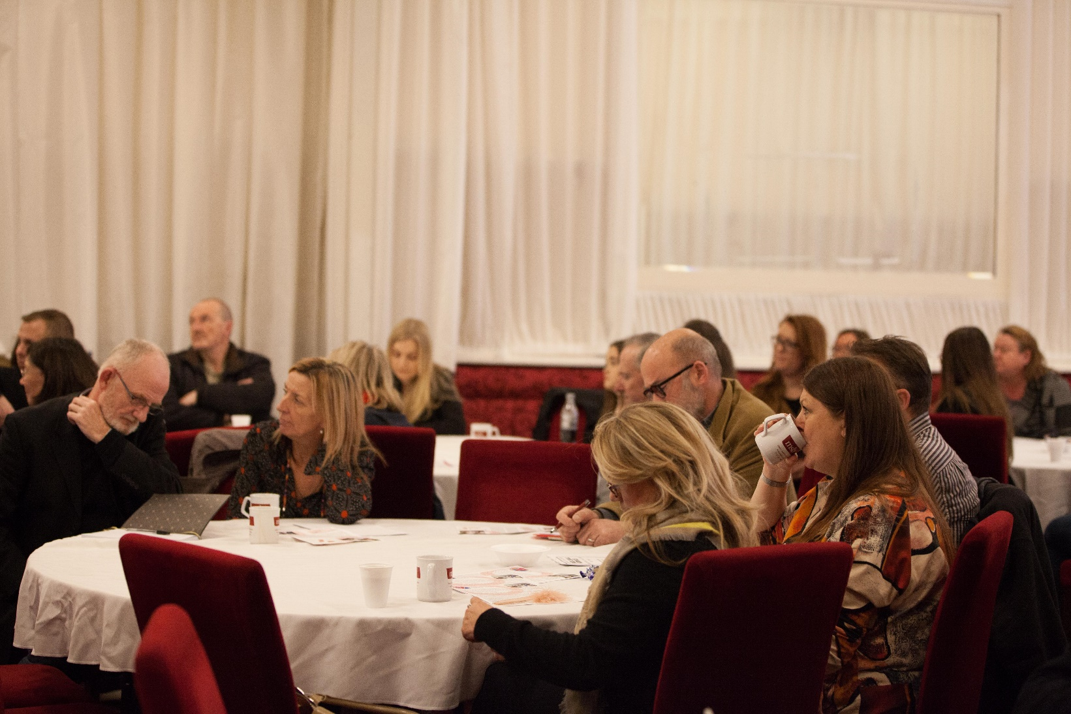

Slide 21
1973
Where it all began for VCLIC...
Based in an area adjacent to the Liverpool Docks, suffering from exceptionally high levels of disadvantage and poverty.
Set up as a result of collaboration between the local community, the Council, Liverpool Law Society and the John Moores Foundation.
Excellent reputation for delivering a high quality free legal advice service combatting poverty.
Members of the National Law Centre's Network and provides
services accredited to the Advice Quality Service Standard.
Registered Charity and Company limited by guarantee.

Slide 22
COMBAT SOCIAL EXCLUSION.
SERVICE AIMS...
Raising income levels and helping to control debt levels through
legal advice work
PROMOTE EQUALITY.
PROVISION OF LEGAL ADVICE.
Actively challenging discrimination through legal advice and representation
Providing information to people who wouldn't have access, so they can better assert their rights
REDUCE POVERTY AND IMPROVE HEALTH AND WELL-BEING.
PROMOTION OF FREE LEGAL ADVICE.
Provide high quality and independent legal advice service which is free to users
Promoting independence to disabled people and their carers

Slide 23
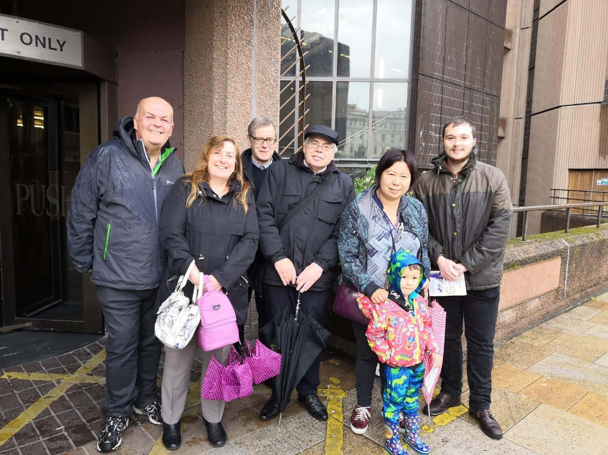
Where are we now?
2500 queries
750 cases opened
5 new board members
Over £1 million recovered in benefits
Over £300,000 debt managed
2 new full time members of staff
Year to date…

Slide 24
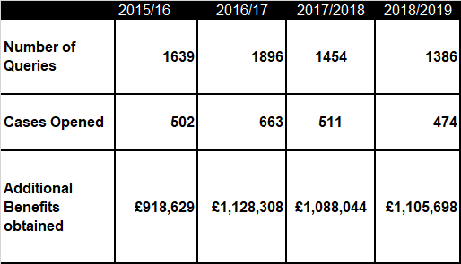
Impact of Law Centre

Slide 25
Business Plan Diagram
ADVICE
SOCIAL POLICY & EDUCATION
Welfare Benefits
Debt
Housing
Employment
Immigration
Community Care
Solicitors - Wills, Family law
Social Media
Training volunteers, students, trainee solicitors, advice workers, other agencies
Networking to demand change
Working with other agencies such as CPAG & PLP
Case studies
VCLIC
Tools, Apps
Face to Face
advice
OUTREACH & AFFILIATIONS
Unions
MPs
GPs
Social workers
other agencies for joint working
Universities
Probation Service
Local advice agencies such as Inside Connections

Slide 26
CASE STUDY
Mr F suffers with widespread arthritis and anxiety and depression.
He was found fit for work by the DWP and his benefit was stopped.
His claim for Personal Independence Payment was also refused.
The Law Centre helped him to appeal both decisions and represented at the two separate hearings during 2018.
The first tribunal accepted that he was not fit for work as his ability to walk was so restricted that he was placed in the support group for Employment and Support Allowance.
The second tribunal concluded that as a result of his physical and mental health disabilities he qualified for an award of both the daily living and mobility components of PIP. As a result of the award of the daily living component Mr. Frost also became entitled to additional ESA known as the severe disability premium.
As a result of these tribunal decisions Mr. F became entitled to additional benefit totalling in excess of £230 per week, thus increasing his benefit entitlement by over 400%.

Slide 27
CASE STUDY
Mr X was awarded 0 points for the daily living component and 0
points for the mobility component.They had previously been in receipt of
high rate Disability Living Allowance for the mobility component, no care
component. The client is aged 70.
Client suffers with ischemic heart disease, osteoporosis, gout, diabetes, peripheral vascular disease, shadowed and blurred vision in left eye condition, anxiety, depression, memory problems, pernicious anemia.
Tribunal took place on Monday 19th August 2019.
The appeal was allowed, enhanced for both components of daily living and mobility as from 8th February 2018. The decision notice states it was inappropriate to fix a term.
He is also in receipt of Guaranteed Pension Credit, lives alone, no one claims Carer’s Allowance for him, he will be able to have severe disability addition added to his award on this including backdate.
The client’s weekly financial gain is £214.70 weekly, estimated backpay of £16,961.30.
The client’s niece, as his named driver can apply for 100% road tax concession and the client can apply for a Blue Badge for parking.

Slide 29
Vauxhall Community Law & Information Centre
VNC Millennium Resource Centre
Blenheim Street
Liverpool
L5 8UX
0151 482 2540
@vlciverpool
www.facebook.com/VLCLiverpool/
ngaryanli@vauxhalllawcentre.org.uk
Advice@vauxhalllawcentre.org.uk

